Slide 1
Tech Module: Goals
"Technology Fundamentals" Module @ SoftUni
5 times weekly, lots of live coding and exercises
Part I – Programming Fundamentals
Arrays, lists, dictionaries, collections, lambda and LINQ, objects, files, strings, regular expressions, …
Part II – Software Technologies
Get acquainted with the most popular technologies out today
HTML, PHP Web, JavaScript Web, Java Web, C# Web

Slide 2
Tech Module at SoftUni – Timeline
22-May-2017
09-Jul-2017
Sep-2017
Programming Fundamentals
Lessons + exercises + exam
7 weeks * 5 times / week
6 credits
Start: 22-May-2017
Final exam: 09-Jul-2017
Software Technologies
Lessons + exercises + exam
5 weeks * 5 times / week
12 credits
Start: 10-Jul-2017
Final exam: 02-Sep-2017
Programming Fundamentals Re-Take Exams
First week of September 2017

Slide 3
Professions @ SoftUni
Programming Basics
Java
Fund.
Java
DB
Java
Web
JS Core
Tech Module
C#
Fund.
C#
DB
C#
Web
JS Core
Programming Fundamentals
JS Core
MEAN
Stack
Web
Basics
Software Technologies
PHP
Web
Web
Basics
JS Core
https://softuni.bg/curriculum
https://softuni.bg/trainings/courses

Slide 4

Programming Fundamentals
Course Objectives & Program

Slide 5

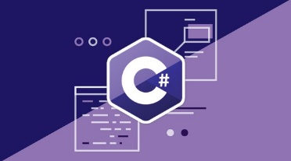
Programming Fundamentals – Course Program
Course Introduction – Course Program, Trainers, Exams, Resources
C# Intro: Basic Syntax, Using Visual Studio
C# Intro: Conditional Statements and Loops
Git & GitHub – Version Control Systems
Data Types – Numeral Types and Type Conversion
Methods and Debugging – Finding and Fixing Bugs in Programs
Arrays – Simple Array Processing
Lists – Processing Variable Length Sequences

Slide 6
Programming Fundamentals – Course Program (2)
Dictionaries, Lambda and LINQ – Collections and Queries
Objects and Simple Classes – Use / Define Objects and Classes
Files, Directories, Exceptions – Working With the File System and Handling Exceptions
Strings and Text Processing – Processing and Manipulating Text
Regular Expressions – Modern Text Processing
Exam Preparation – Practical Exam Problems (4 times)
Practical Exam – 4 Problems for 6 Hours

Slide 7

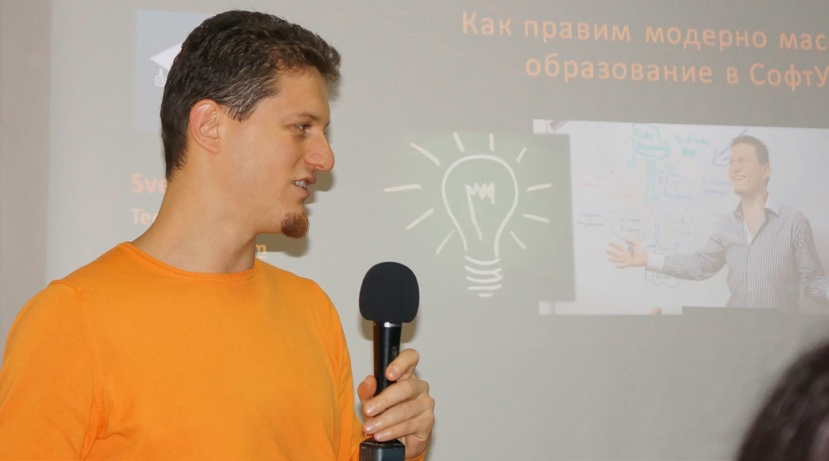
Training Duration – Programming Fundamentals
Lessons: ~50 hours (onsite + videos)
Practical exercises (in class): ~100 hours
Exam preparation: 4*4 hours
Exam: 6 hours
Schedule: May – Jul 2017
Exam date: 09 July 2017

Slide 8
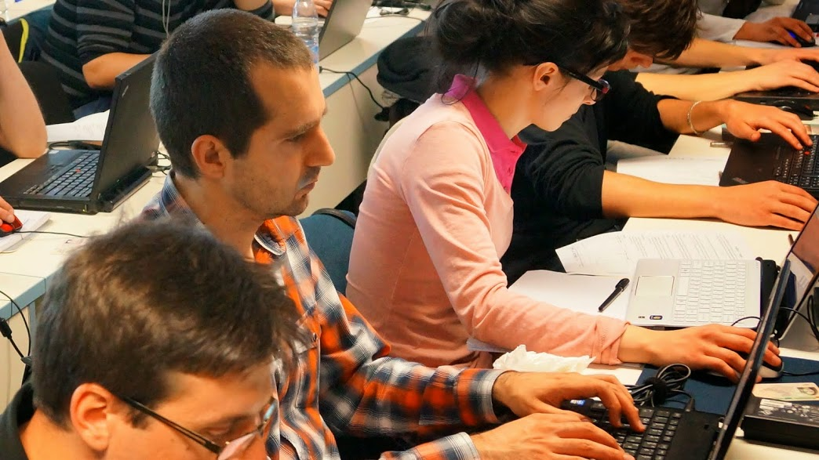
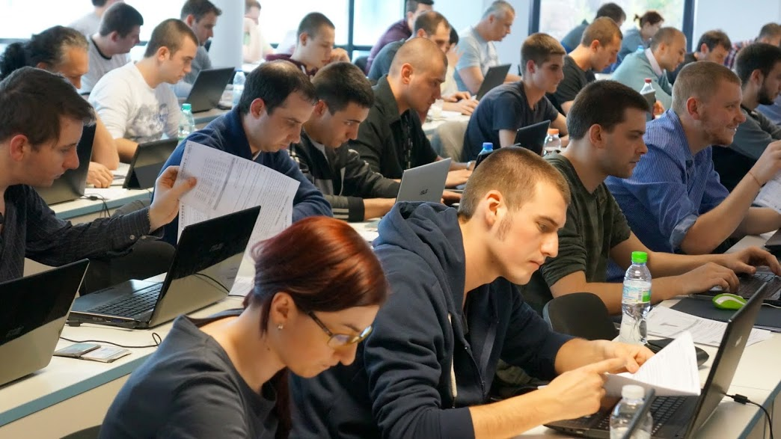

Programming Fundamentals
Evaluation Criteria

Slide 9


Scoring System for “Programming Fundamentals”
Exam – 90%
Homework (exercises) – 10%
Bonuses: up to 10%
Presence in class: 5% (onsite students only)
Forum activities
Others

Slide 10
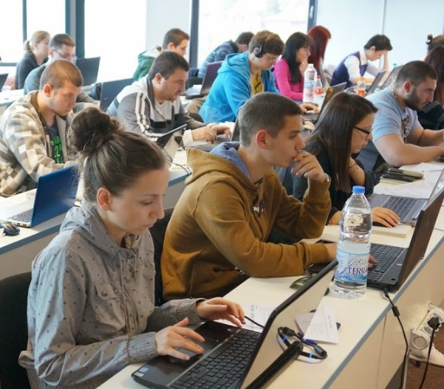

Programming Fundamentals Exam
Practical programming exam
4 practical problems for 6 hours
Simple arrays, lists, dictionaries, strings
Code in C# (Java, PHP, JS are also welcome)
Automated judge system
http://judge.softuni.bg
Solutions are evaluated for correctness only
Code quality is still not measured

Slide 11

Homework Assignments
Doing your homework is very important!
Programming can only be learned through a lot of practice!
You should write code every day!
Each lesson is followed by many exercises
Try to solve them in class
The rest are your homework
Homework assignments are due in 6 days after each lecture
Submission through our online judge system: judge.softuni.bg

Slide 12
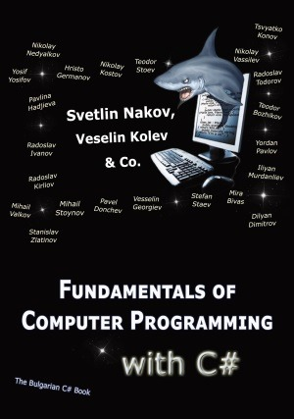

The Free C# Fundamentals Textbook
Partial textbook for the course:
"Fundamentals of Computer Programming with C#", by Svetlin Nakov & Co., 2013, ISBN 9789544007737
English and Bulgarian versions (as PDF, ePub, …)
Freely downloadable from: www.introprogramming.info
The C# Programming courses @ SoftUni.bg partially follows the book
Programming Fundamentals → chapters 2, 3, 7, 9, 11, 13, 14, 16, 18, 22

Slide 13

Software University Learning System (SULS)
Software University Learning System (SULS)
www.softuni.bg
Important resource for students
Homework submissions
Homework check-up
Exams and results
Reports about your progress

